Slide 1
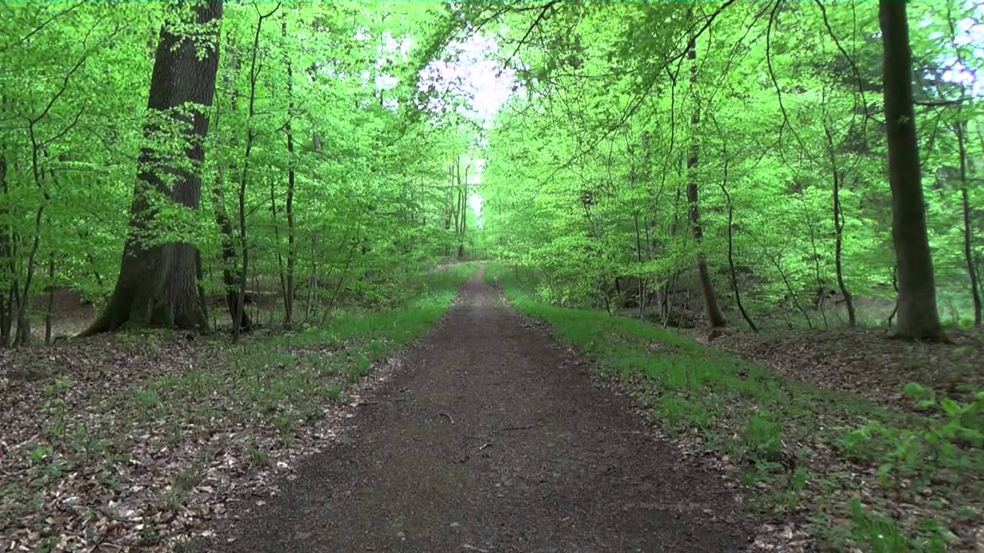
Fire Recognition in forests using Deep Learning -WORKING WITH CONVOLUTION NEURAL NETWORKS Guide – Dr. Prabha Selvaraj
DONE BY:
Sai Sheshank Gaddam
17MIS7099

Slide 2
ABSTRACT
This project is aimed at the areas where the fire combustion takes place to save the wildlife animals and people situated around. A large forest fire causes a serious impact on the environment, determining its future for decades.
Prevention of forest fires is one of today's most important tasks as well as appropriate preparedness for effective fighting against them. To do so, it is vital to have detailed knowledge on AI, deep learning techniques to visualize/recognize whether the forests are with fire or without fire through the images which we give the model to predict.

Slide 3
OBJECTIVE
The main objective of our project is to control forest fires and strengthen the forest protection and create a user-friendly environment where anyone should be able to use. Also, they should be able to access the software from anywhere and anytime.

Slide 4
INTRODUCTION
Forest fires are a major environmental issue, creating economic and ecological damage while endangering human lives. There are typically about 100,000 wildfires in the United States every year. Over 9 million acres of land have been destroyed due to treacherous wildfires. It is difficult to predict and detect Forest Fire in a sparsely populated forest area and it is more difficult if the prediction is done using ground based methods like Camera or Video Based approach. Satellites can be an important source of data prior to and also during the Fire due to its reliability and efficiency. Forest fires destroy a total area of 3.5 to 4.5 million km. Here we are going to train the model in such a way that if you give an image/picture of the forest it will detect whether the forest is with fire or without fire. And if it recognizes the fire picture it puts on an alarm sound. This helps us to find out the forest combustion in an easy way by staying even at home.

Slide 5
PROBLEM STATEMENT
By this project we are able to meet the main demands of the client. The existing system does not make any detection of the fire of its own unless we place/have any sensors to identify them so, human has to waste their time to go and check around the forest. But new system which we are going to develop can predict the fire by using images developed by CNN (analyzing visual imagery). This can be very tedious and time consuming, resulting in users to refraining from using these applications for long periods of time. So, by using deep learning technique - CNN we are able to achieve the goal of our project.

Slide 6
Literature Survey And Inference
Forest fire risk prediction algorithm, based on support vector machines, is presented.
Forest ﬁre risk prediction mechanism, based only on meteorological data and independent of any weather prediction mechanism. The results demonstrates the ability to predict forest ﬁre risk with a limited amount of data and has shown that support vector machines can be used for a two-class prediction of ﬁre risk with a very high accuracy of up to 96% for August as well as four classes prediction with a low error on the number of ﬁres as well as on the predicted scale.
The implementation of the algorithm using data from Lebanon demonstrated its ability to accurately predict the hazard of fire occurrence.

Slide 7
Motivation
Reduce the Forest combustions.
Use the technology ( AI ) for the best that could do for the society.
For our future, we need to protect our present trees and forests.

Slide 8
EXISTING V/S PROPOSED WORK
Existing: People of forests (Forest officers or people near to the forests’) used to check manually whether the forest have caught any fire or using the sensors of UV they gets alert of the fire. This procedure causes us to the great loss.
Proposed: The proposed Forest Fire Prediction model is based on neural networks (CNN) incorporated to an alert system. The developmental approach of the proposed system includes two modules:
Forest Fire Identification: Identification of fire affected areas.
Forest Fire Management: Remedial measures for Forest Fire is all about detecting where the fire initiated in the forest.
In our proposed system we made an effort to classify the images of forest with fire and forest without fire for further using convolution neural networks. Since the CNNs are capable of handling a large amount of data and can estimate the features automatically, they have been utilized for the task of forest combustion recognition. The forest dataset of train and test has been selected as the working GUI for this approach. Here we select a sample of few images (each approx..100) with fire and without fire segregate them into train and test and model predicts them perfectly depending upon accuracy.

Slide 9
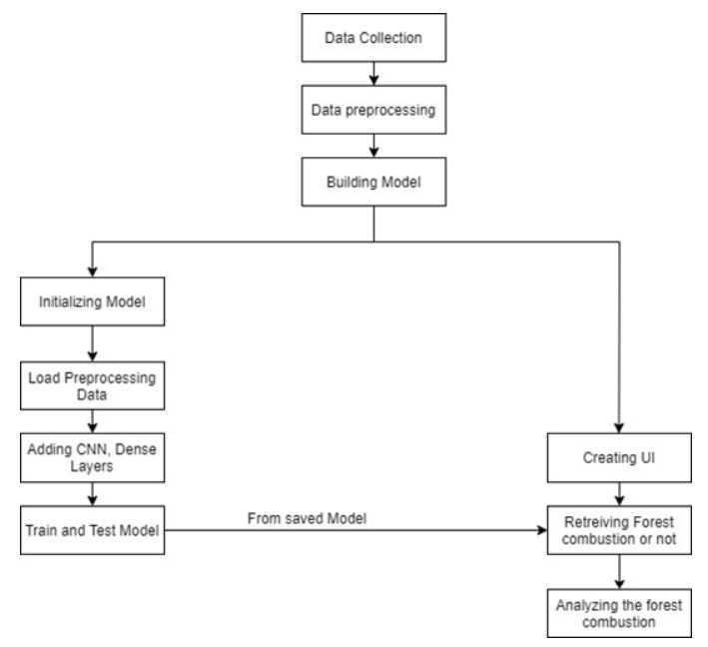
TIMELINE || WORK FLOW
Model building – Aug - 10
Accuracy and Prediction – Aug – 15
UI and Final Output – Aug - 20

Slide 10
DESCRIPTION – Technology Using.
Algorithm Used – CNN
The algorithm which we have used is based on deep learning technique named CNN (most commonly applied to analysing visual imagery), there are many other techniques in deep learning with AI but we choose CNN because we are working with images and it is the best way to predict images accurately. They are also known as shift invariant or space invariant artificial neural networks
A Convolutional Neural Network (CNN) is a Deep Learning algorithm and is a combination of Convolution Layers and Neural Network which can take in an input image, assign importance to various aspects/objects in the image and be able to differentiate one from the other.

Slide 11
FUTURE Scope/Works
The vital requirements of an autonomous early forest combustion recognition system, its main modules and methods for wildfire management and risk assessment, smoke and combustion detection, it have been done based on images. We will train and test the model then after the prediction and make the alarm sound in Jupyter Notebook. Further we wanted to develop our UI linked to the html page by getting the alarm in our system and make our model to run more rapidly and accurately.

Slide 12
Hardware and Software requirements
6 GB RAM, 512 GB Memory, i5/i7 processor
Jupyter Notebook, anaconda.
keras, tensorflow
python.

Slide 13
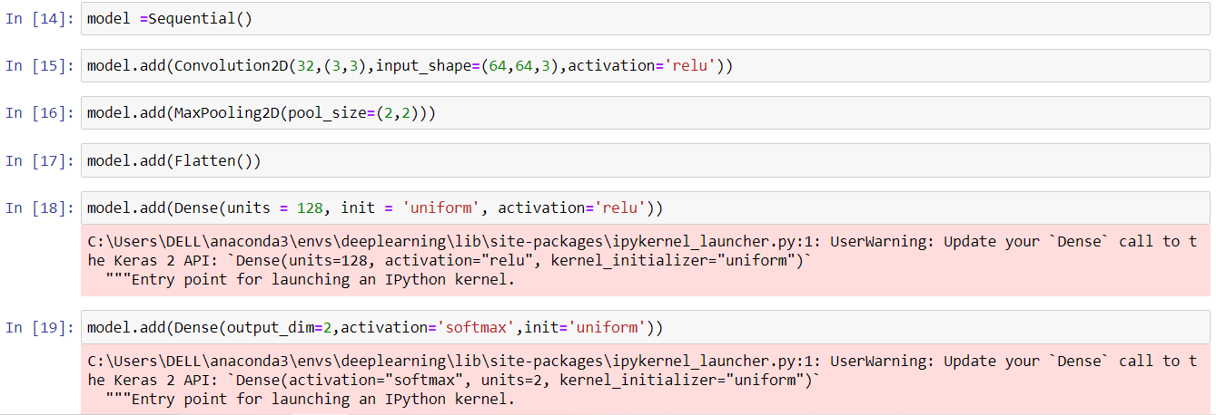
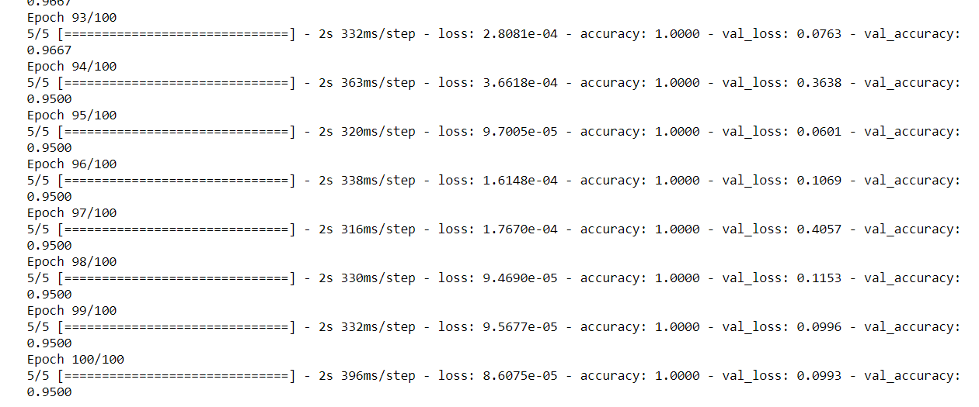
1 - Hidden Layers – 95%

Slide 14
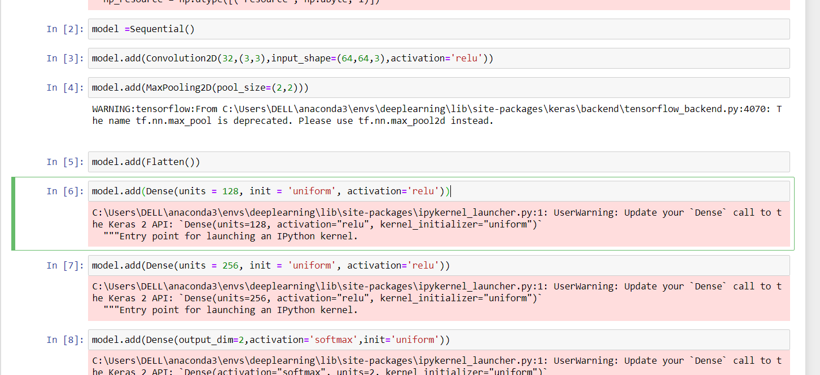
2 - Hidden Layers – 95%

Slide 15
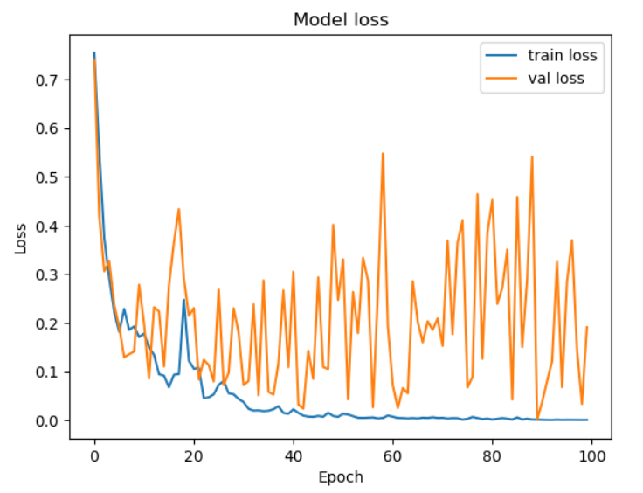
Results

Slide 16
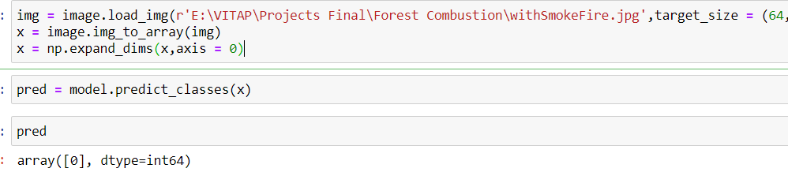
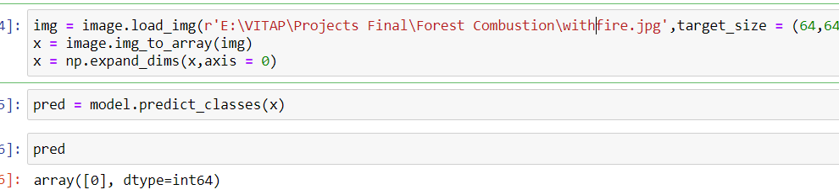
With Smoke Fire
With Fire

Slide 17
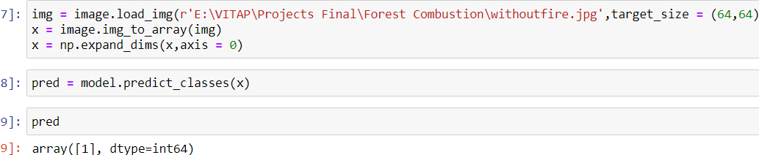
Without Fire

Slide 18
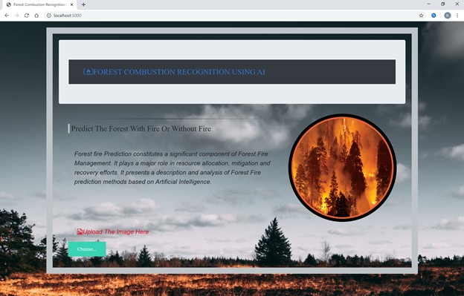
Homepage

Slide 19
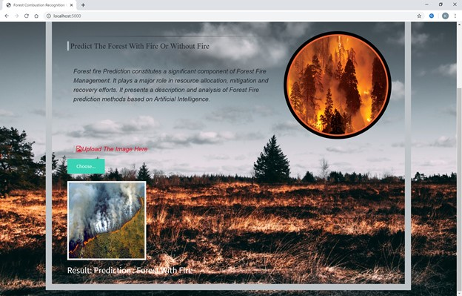
Result: Forest With Fire

Slide 20
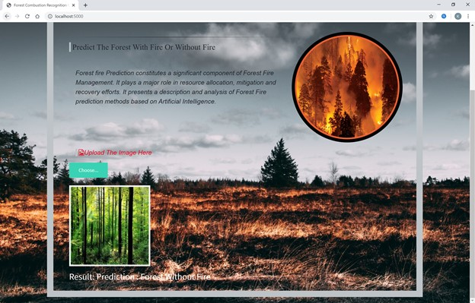
Result: Forest Without Fire

Slide 21
CONCLUSION
We developed this project using AI, Deep learning techniques (CNN), python3. This study proposes an effective forest fire detection method using image processing techniques. The algorithm uses Train and test model. It will train our model and further it test whether fire is present or not. Five fire detection rules are applied to detect the fire. The performance of the proposed algorithm is tested on data set consisting of various pictures of forest collected from Internet, 100 of which were actual fire pictures , while another 100 were without fire. The results show that the proposed algorithm achieves good detection rates. These results indicate that the proposed method is accurate and can be used in automatic forest fire-alarm systems.

Slide 22
REFERENCES
[1] Anon, 1995. Report of the Committee of Enquiry into Forest Fires in Himachal Pradesh and Uttar Pradesh in 1995, Government of India.
[2] Bahuguna, V.K. and Upadhyay, A., 2002. Forest fires in India: Policy initiatives for community participation; International Forestry Review, 4(2).
[3] FAO, 2003.Wildland Fire Management Terminology. FAO Forestry Paper 70. FAO, Rome.
[4]https://www.researchgate.net/publication/261272818_Artificial_intelligence_for_forest_fire_prediction
[5] https://ieeexplore.ieee.org/document/5695809/metrics#metrics

Slide 23

QUERIES

Slide 24

THANK YOU

